Slide 1
Chapter 7 Object-Oriented Programming

Slide 2

Motivations
After learning the preceding chapters, you are capable of solving many programming problems using selections, loops, and functions.
However, these Python features are not sufficient for developing graphical user interfaces and large scale software systems.
Suppose you want to develop a graphical user interface as shown below. How do you program it?

Slide 3
Objectives
To describe objects and classes, and use classes to model objects (§7.2).
To define classes (§7.2.1).
To construct an object using a constructor that invokes the initializer to create and initialize data fields (§7.2.2).
To access the members of objects using the dot operator (.) (§7.2.3).
To reference an object itself with the self parameter (§7.2.4).
To use UML graphical notation to describe classes and objects (§7.3).
To distinguish between immutable and mutable (§7.4).
To hide data fields to prevent data corruption and make classes easy to maintain (§7.5).
To apply class abstraction and encapsulation to software development (§7.6).
To explore the differences between the procedural paradigm and the object-oriented paradigm (§7.7).

Slide 4
Procedural Programming
Procedural programming: writing programs made of functions that perform specific tasks
Procedures (functions) typically operate on data items that are separate from the procedures
Data items commonly passed from one procedure to another
Focus: to create procedures that operate on the program’s data

Slide 5
OO Programming Concepts
Object-oriented programming (OOP) involves programming using objects.
An object represents an entity in the real world that can be distinctly identified. For example, a student, a desk, a circle, a button, and even a loan can all be viewed as objects.
An object has a unique identity, state, and behaviors.
The state of an object consists of a set of data fields (also known as properties) with their current values. The behavior of an object is defined by a set of methods.

Slide 6
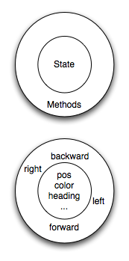
Object’s State and Methods
In Python, every value is actually an object. Whether it be a turtle, a list, or even an integer, they are all objects.
Programs manipulate those objects either by performing computation with them or by asking them to perform methods.
To be more specific, we say that an object has a state and a collection of methods that it can perform.
>>>turtle.color(“blue”)
>>> turtle.position()
(0.00,0.00)
>>> turtle.forward(25)
>>> turtle.position()
(25.00,0.00)
>>> turtle.forward(-75)
>>> turtle.position()
(-50.00,0.00)

Slide 7
Object’s State and Methods
The state of an object represents those things that the object knows about itself. For example, as we have seen with turtle objects, each turtle has a state consisting of the turtle’s position, its color, its heading and so on.
Each turtle also has the ability to go forward, backward, or turn right or left.
Individual turtles are different in that even though they are all turtles, they differ in the specific values of the individual state attributes (maybe they are in a different location or have a different heading).

Slide 8

import turtle
wn = turtle.Screen() # Set up the window and its attributes
wn.bgcolor("lightgreen")
tess = turtle.Turtle() # create tess and set some attributes
tess.color("hotpink")
tess.pensize(5)
alex = turtle.Turtle() # create alex
tess.forward(80) # Let tess draw an equilateral triangle
tess.left(120)
tess.forward(80)
tess.left(120)
tess.forward(80)
tess.left(120) # complete the triangle
tess.right(180) # turn tess around
tess.forward(80) # move her away from the origin
alex.forward(50) # make alex draw a square
alex.left(90)
alex.forward(50)
alex.left(90)
alex.forward(50)
alex.left(90)
alex.forward(50)
alex.left(90)
wn.exitonclick()
Object’s
State and Methods

Slide 9
Classes
Class: code that specifies the data attributes and methods of a particular type of object
Similar to a blueprint of a house or a cookie cutter
It is simply a template that we construct objects from it.
Instance: an object created from a class
Similar to a specific house built according to the blueprint or a specific cookie
There can be many instances of one class

Slide 10
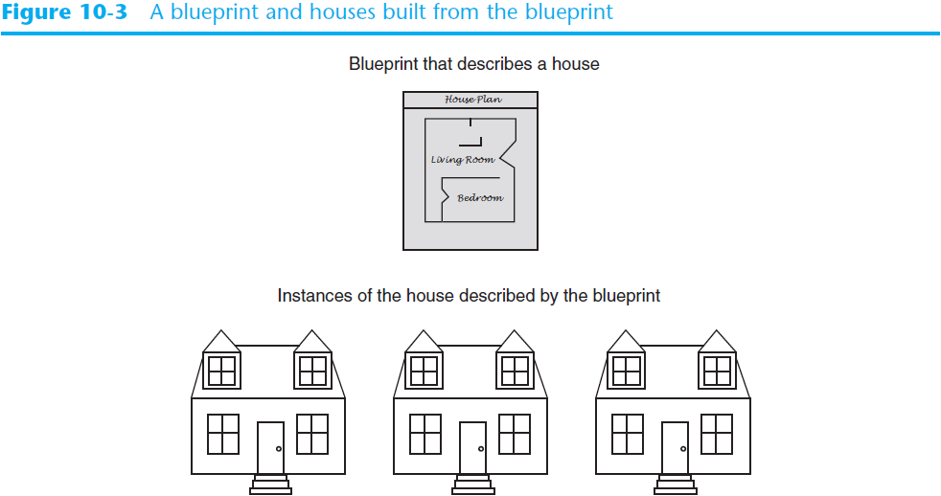
Classes (cont’d.)

Slide 11
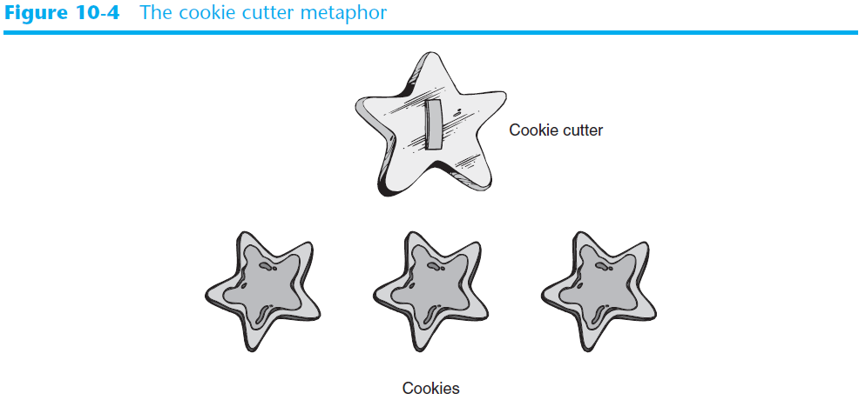
Classes (cont’d.)

Slide 12
Objects
An object has both a state and behavior. The state defines the object (Data Fields), and the behavior defines what the object does (Methods).

Slide 13
Classes
A Python class uses variables to store data fields and defines methods to perform actions. Additionally, a class provides a special type method, known as initializer, which is invoked to create a new object. An initializer can perform any action, but initializer is designed to perform initializing actions, such as creating the data fields of objects.
class ClassName:
initializer
methods
Circle
TestCircle
Run

Slide 14
Constructing Objects
Once a class is defined, you can create objects from the class by using the following syntax, called a constructor:
className(arguments)

Slide 15
Constructing Objects
The effect of constructing a Circle object using Circle(5) is shown below:

Slide 16
Instance Methods
Methods are functions defined inside a class.
They are invoked by objects to perform actions on the objects.
For this reason, the methods are also called instance methods in Python.
You probably noticed that all the methods including the constructor have the first parameter self, which refers to the object that invokes the method.
You can use any name for this parameter. But by convention, self is used.

Slide 17
Accessing Objects
After an object is created, you can access its data fields and invoke its methods using the dot operator (.), also known as the object member access operator.
For example, the following code accesses the radius data field and invokes the getPerimeter and getArea methods.
>>> from Circle import Circle
>>> c = Circle(5)
>>> c.getPerimeter()
31.41592653589793
>>> c.radius = 10
>>> c.getArea()
314.1592653589793

Slide 18
Why self?
Note that the first parameter is special. It is used in the implementation of the method, but not used when the method is called.
So, what is this parameter self for? Why does Python need it?
self is a parameter that represents an object. Using self, you can access instance variables in an object. Instance variables are for storing data fields.
Each object is an instance of a class. Instance variables are tied to specific objects. Each object has its own instance variables.
You can use the syntax self.x to access the instance variable x for the object self in a method.
self parameter is required in every method in the class – references the specific object that the method is working on

Slide 19
UML Class Diagram
UML : short for Unified Modeling Language, is a standardized modeling language consisting of an integrated set of diagrams, developed to help system and software developers for specifying visualizing, constructing, and documenting the artifacts of software systems, as well as for business modeling and other non-software systems.

Slide 20
Example: Defining Classes and Creating Objects
TV
TestTV
Run

Slide 21
Trace Code
animation
Assign object reference to myCircle
myCircle = Circle(5.0)
yourCircle = Circle()
yourCircle.radius = 100
myCircle
reference value

Slide 22
Trace Code
animation
myCircle = Circle(5.0)
yourCircle = Circle()
yourCircle.radius = 100
myCircle
reference value
Assign object reference to yourCircle
yourCircle
reference value

Slide 23
Trace Code
animation
myCircle = Circle(5.0)
yourCircle = Circle()
yourCircle.radius = 100
myCircle
reference value
Modify radius in yourCircle
yourCircle
reference value

Slide 24
The datetime Class
from datetime import datetime
d = datetime.now()
print("Current year is " + str(d.year))
print("Current month is " + str(d.month))
print("Current day of month is " + str(d.day))
print("Current hour is " + str(d.hour))
print("Current minute is " + str(d.minute))
print("Current second is " + str(d.second))

Slide 25
Encapsulation
Encapsulation is one of the fundamental concepts in object-oriented programming (OOP).
It describes the idea of bundling data and methods that work on that data within one unit, e.g., a class.
This concept is also often used to hide the internal representation, or state, of an object from the outside. This is called information hiding.

Slide 26
Information Hiding
You can use the encapsulation concept to implement an information-hiding mechanism.
To protect data.
To make class easy to maintain.
You implement this information-hiding mechanism by making your class attributes inaccessible from the outside

Slide 27
Information Hiding
To prevent direct modifications of data fields, don’t let the client directly access data fields.
This can be done by defining private data fields. In Python, the private data fields are defined with two leading underscores.
You can also define a private method named with two leading underscores.
If it is needed, you can provide getter and/or setter methods for attributes that shall be readable or updatable by other classes.
CircleWithPrivateDataRadius

Slide 28
Data Field Encapsulation
CircleWithPrivateDataRadius
>>> from CircleWithPrivateRadius import Circle
>>> c = Circle(5)
>>> c.__radius
AttributeError: 'Circle' object has no attribute '__radius'
>>> c.getRadius()
5

Slide 29
Design Guide
If a class is designed for other programs to use, to prevent data from being tampered with and to make the class easy to maintain, define data fields private (hide).
If a class is only used internally by your own program, there is no need to encapsulate the data fields.

Slide 30
Getter and Setter Methods
Typically, all of a class’s data attributes are private and you have to provide methods to access and change them
Getter (Accessor) methods: return a value from a class’s attribute without changing it
Safe way for code outside the class to retrieve the value of attributes
Setter (Mutator) methods: store or change the value of a data attribute

Slide 31
Class Abstraction and Encapsulation
Class abstraction means to separate class implementation from the use of the class.
The creator of the class provides a description of the class and let the user know how the class can be used.
The user of the class does not need to know how the class is implemented.
The detail of implementation is encapsulated and hidden from the user.

Slide 32
Designing the Loan Class
Loan
TestLoanClass
Run

Slide 33
Object-Oriented Thinking
This book’s approach is to teach problem solving and fundamental programming techniques before object-oriented programming.
This section will show how procedural and object-oriented programming differ.
You will see the benefits of object-oriented programming and learn to use it effectively.
We will use several examples in the rest of the chapter to illustrate the advantages of the object-oriented approach. The examples involve designing new classes and using them in applications.

Slide 34
The BMI Class
BMI
UseBMIClass
Run

Slide 35
Object-Oriented Programming
Object-oriented programming: focused on programming using objects
Object: entity that contains data and procedures (functions or methods)
Data is known as data attributes and procedures are known as methods
Methods perform operations on the data attributes
Encapsulation: combining data and code into a single object

Slide 36
Object-Oriented Programming (cont’d.)
Data hiding: object’s data attributes are hidden from code outside the object
Access restricted to the object’s methods
Protects from accidental corruption
Outside code does not need to know internal structure of the object
Object reusability: the same object can be used in different programs
Example: 3D image object can be used for architecture and game programming

Slide 37
Procedural vs. Object-Oriented
In procedural programming, data and operations on the data are separate, and this methodology requires sending data to methods.
Object-oriented programming places data and the operations that pertain to them in an object. (Encapsulation)
This approach solves many of the problems inherent in procedural programming.

Slide 38
Procedural vs. Object-Oriented
The object-oriented programming approach organizes programs in a way that mirrors the real world, in which all objects are associated with both attributes and activities.
Using objects improves software reusability and makes programs easier to develop and easier to maintain.
Programming in Python involves thinking in terms of objects; a Python program can be viewed as a collection of cooperating objects.

